Slide 1

Design Sprint Foundations
Project 1: The Concept

Slide 2

LONG TERM GOAL
Ooup will be the world’s most known scooter service provider in 2 years.
SPRINT QUESTIONS
1 | Can we increase users ?
2 | Can we make users spend more time on riding scooters ?
3 | Can we make users return the scooter to the station ?

Slide 3
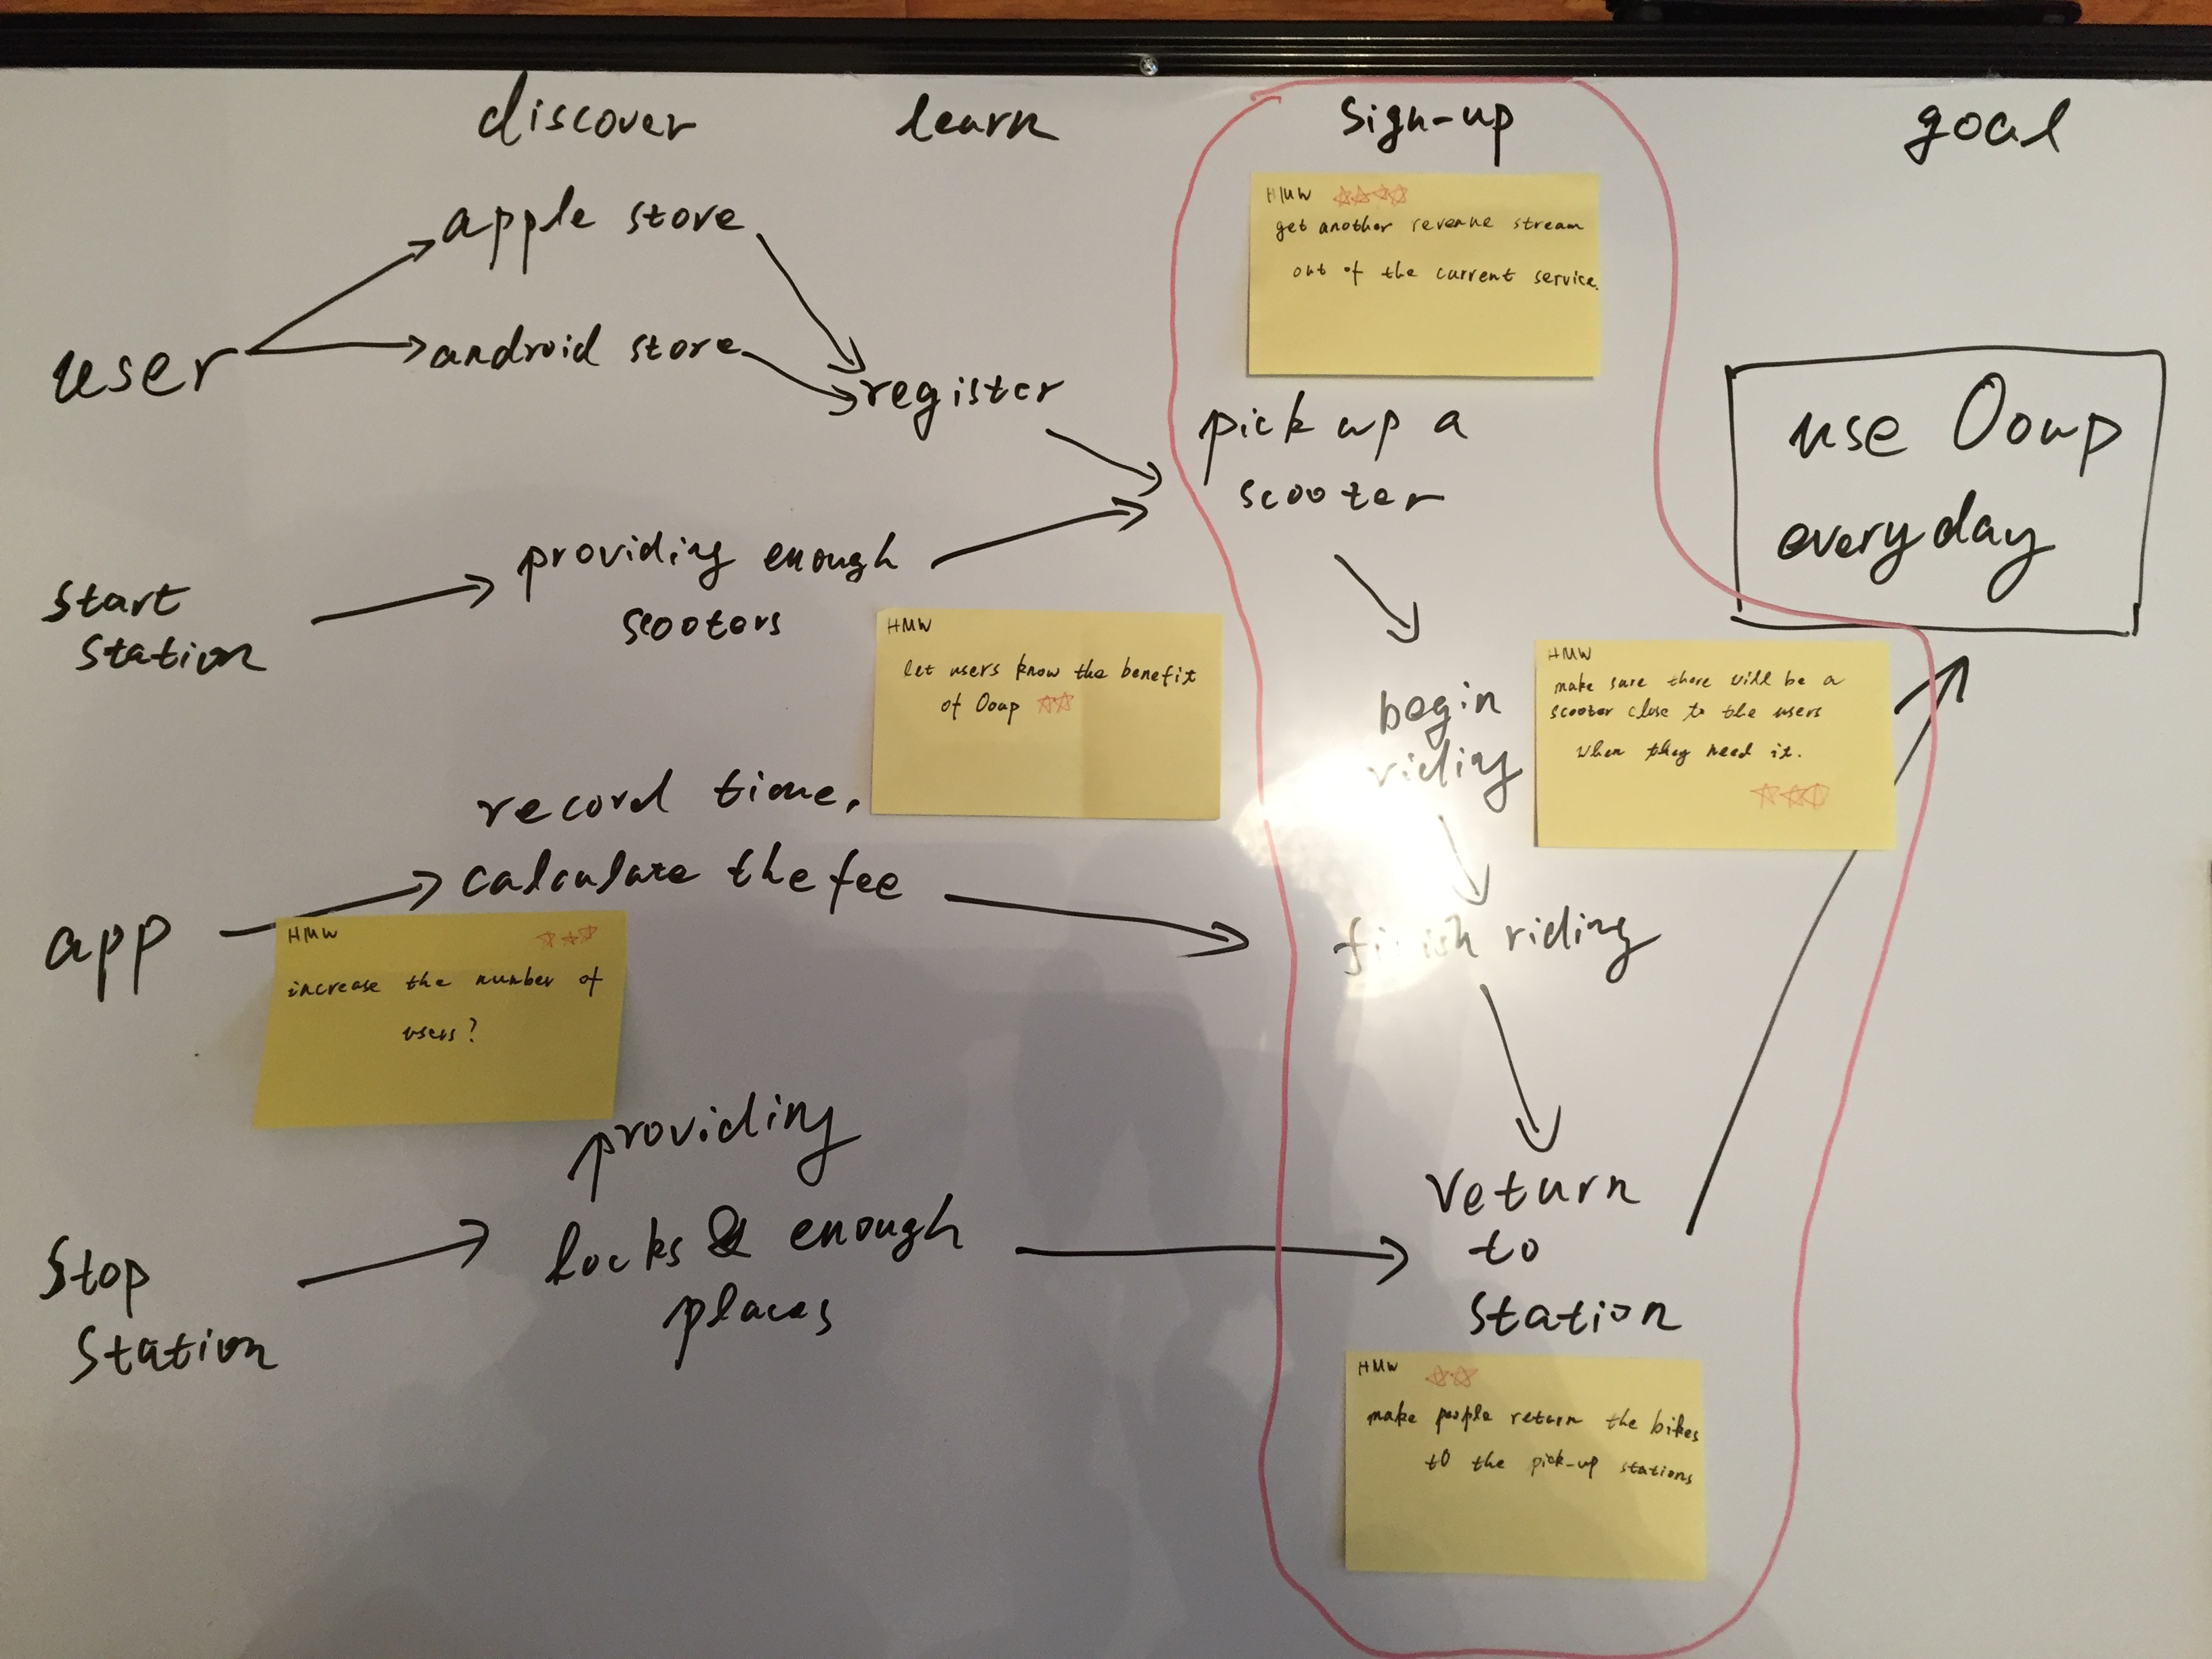
YOUR USER STORY MAP
Your User Story Map goes here!

Slide 4

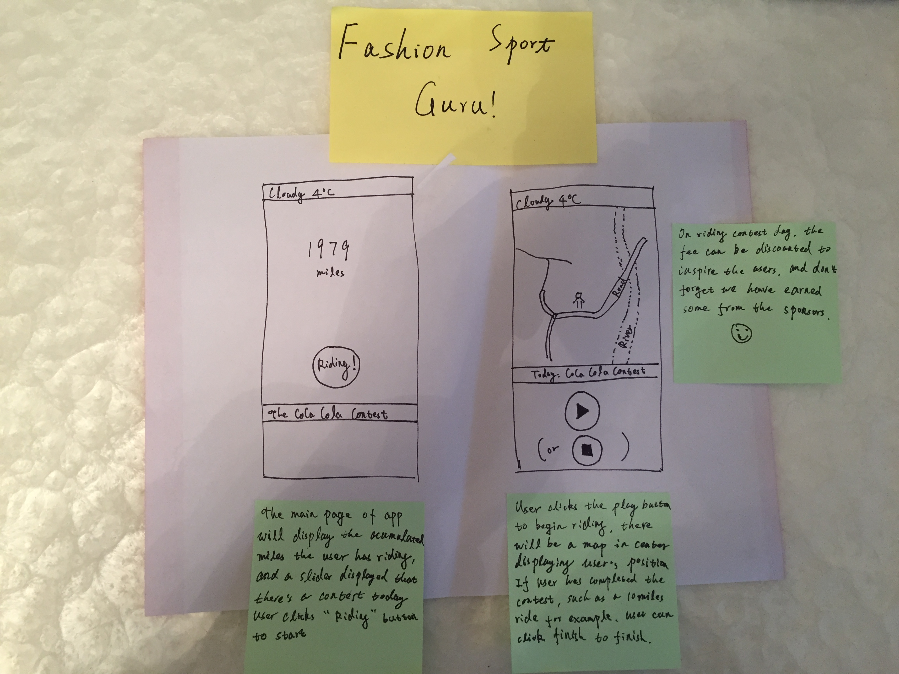
CONCEPT SCREEN 1
insert actual image
Description goes here

Slide 5

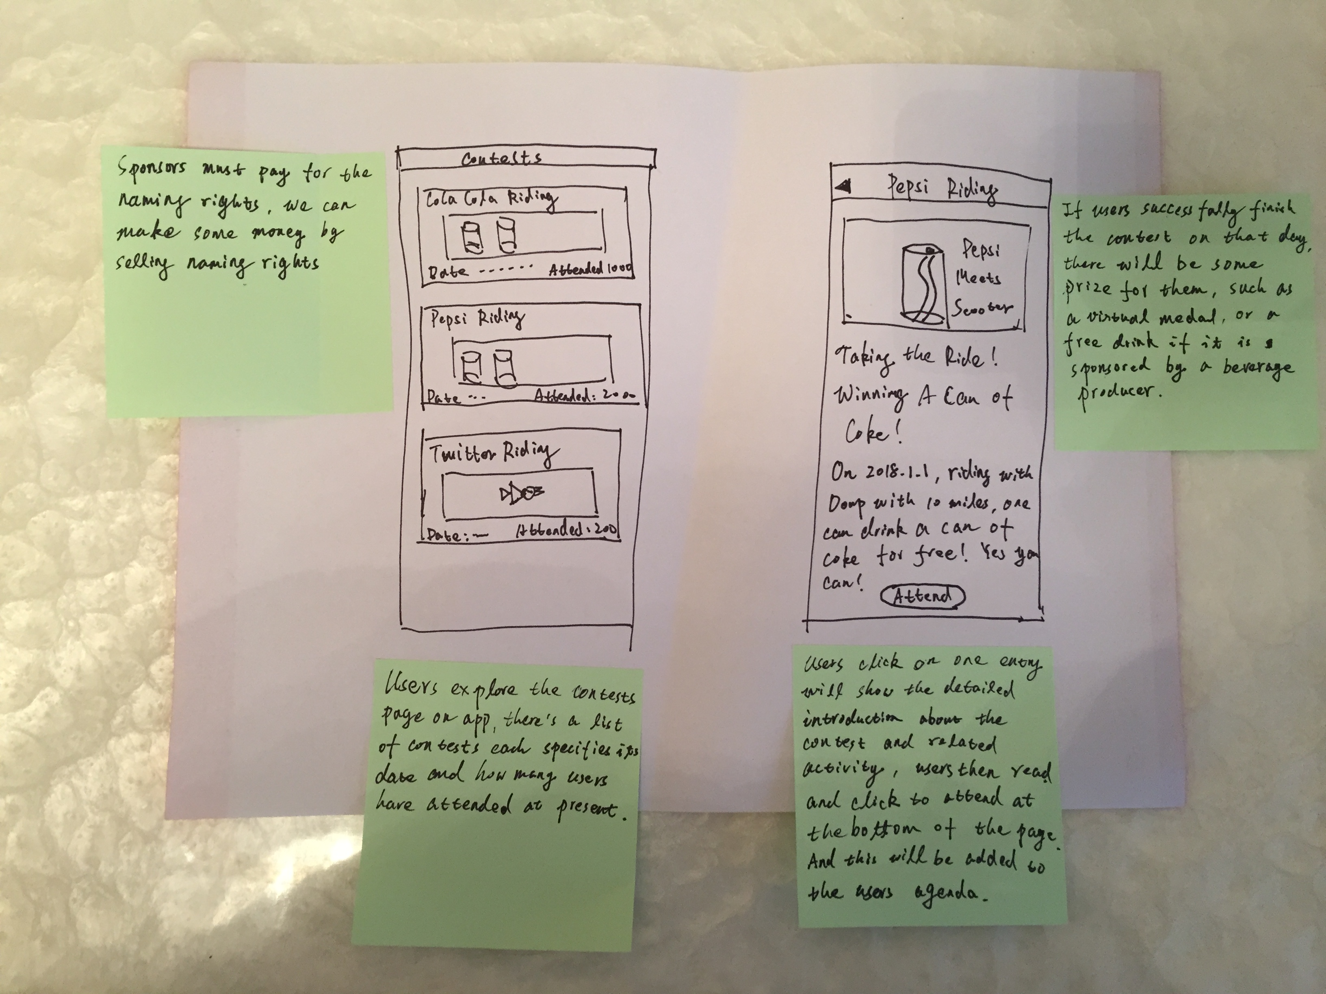
CONCEPT SCREEN 2
insert actual image
Description goes here

Slide 6

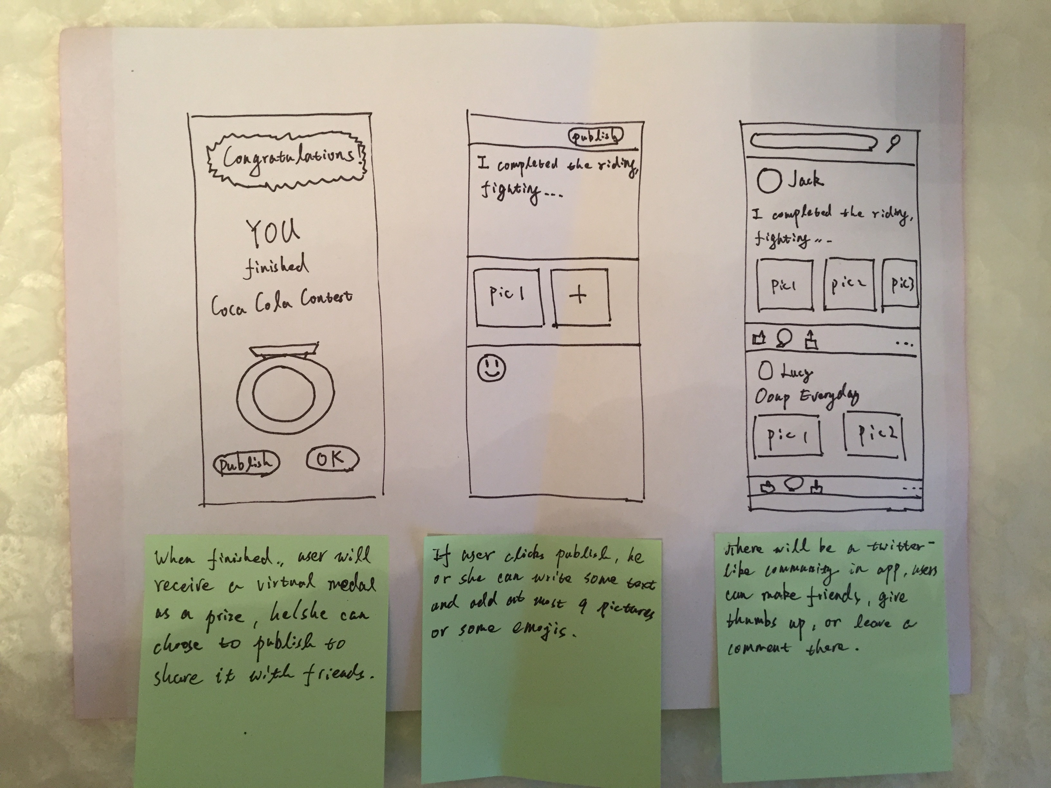
CONCEPT SCREEN 3
insert actual image

